Slide 1

RESUME SCREENING AND EVALUATION SYSTEM
USING SKILL MATCHING.
DEVELOPED BY:
N.PRADEEP - 23CSE3022
CH.NAGATEJA - 23CSE3001
V.VISHWAKSEN - 23CSE3030
M.VENKATESH - 23CSE3010
P.RISHI - 23CSE3039

Slide 2
ABSTRACT
Recruitment involves reviewing a large number of resumes, which is often time-consuming and repetitive.
This project builds a Resume Screening and Evaluation System that automatically extracts skills from resumes, compares them with job requirements, and evaluates candidates using simple rule-based logic.
The system is designed with a modular structure to keep the evaluation process clear, flexible, and easy to improve.

Slide 3
PROBLEM DEFINITION
Organizations receive many resumes for a single job role.
Manually reviewing each resume takes time and can lead to inconsistent decisions.
Main Problems:
  Manual screening is slow
  Difficult to compare candidates fairly
  No structured evaluation method
Problem Statement:
There is a need for an automated system to screen and evaluate resumes efficiently and consistently.

Slide 4
LITERATURE SURVEY SUMMARY
From studying existing recruitment systems:
  Most screening is done manually or with basic keyword tools
  Advanced systems are costly and complex
  Simple rule-based evaluation is rarely implemented clearly
Observation:
There is scope for a lightweight and structured resume evaluation system suitable for academic and small-scale use.

Slide 5
PROPOSED SOLUTION
The proposed system automates resume screening using skill matching.
Key Features:
  Extracts skills from resumes
  Matches skills with job requirements
  Applies weighted scoring
  Classifies candidates based on suitability
Additional features:
  Skill gap analyzer and learning recommendation, Bias reduction module.
Benefit:
Reduces manual effort and improves consistency in resume evaluation.

Slide 6
ADDITIONAL FEATURES
1. Skill Gap Analyzer & Learning Recommendation
This feature identifies missing skills by comparing a candidate’s resume with job requirements. It highlights skill gaps and suggests relevant skills or learning areas for improvement. This helps candidates understand what they need to learn to better match specific job roles.
2. Bias Reduction Module
This module reduces bias during evaluation by focusing only on skill-based criteria. Personal details such as name, age, or background are ignored during scoring, ensuring fair and consistent candidate assessment based purely on skills and job relevance.

Slide 7
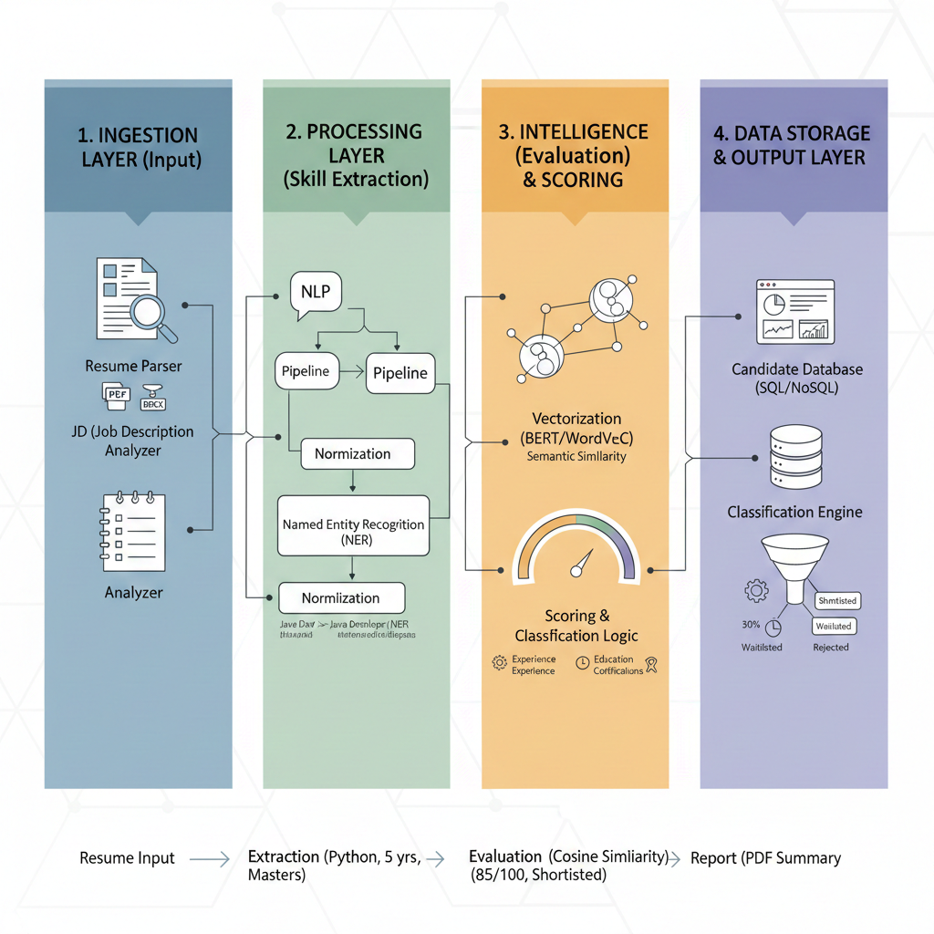
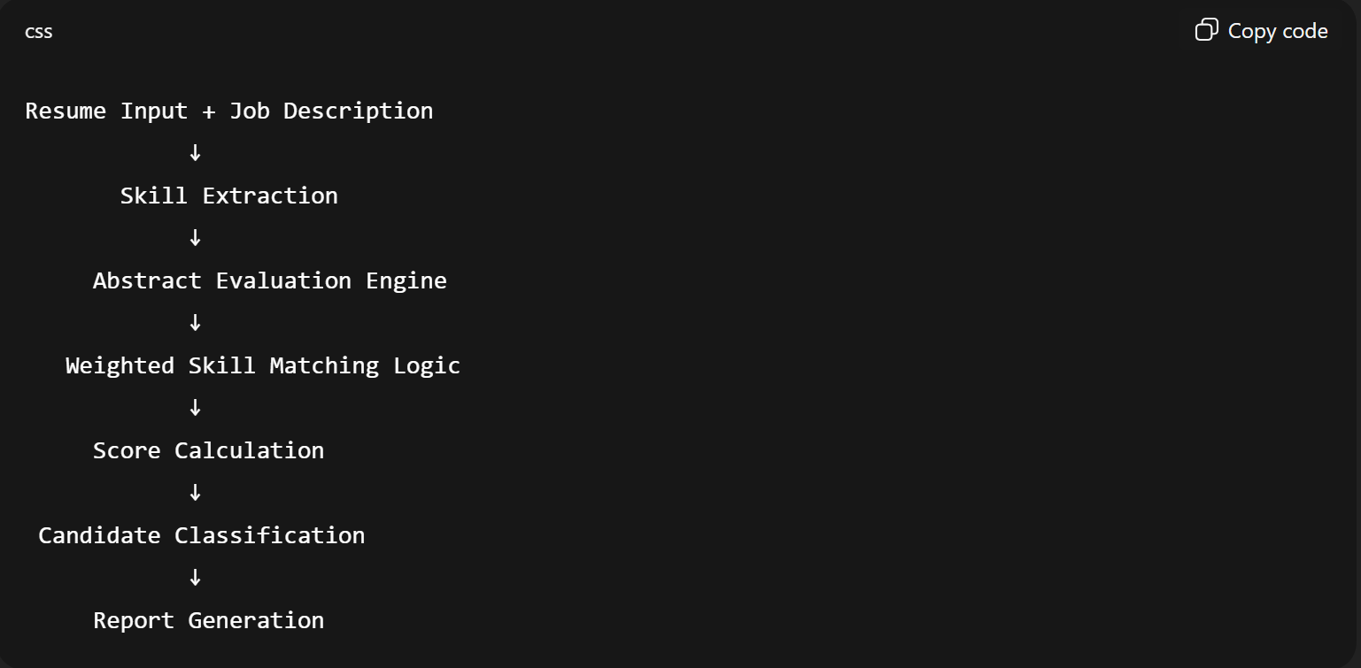
SYSTEM ARCHITECTURE

Slide 8
MODULE-WISE PLAN
  Resume Module:
Accepts resume text as input and performs basic preprocessing before analysis.
  Job Description Module:
Stores job role details along with required and optional skills for evaluation.
  Skill Extraction Module:
Scans resume and job description text to identify relevant skills using a predefined skill set.
  Evaluation Module:
Matches extracted skills, applies weighted scoring logic, and determines candidate suitability.
  Report Module:
Generates a clear summary showing matched skills, final score, and candidate classification.

Slide 9






TOOLS REQUIRED
Python
Object oriented programming
Console interface
Visual Studio Code
Text Files
Windows platform

Slide 10
This project provides a simple and effective approach to resume screening.
By automating skill extraction and evaluation, it helps reduce manual work and supports better shortlisting decisions.
The modular design allows the system to be easily extended in the future.
CONCLUSION

Slide 11

THANK YOU
-Team

